Slide 1
Predicting Heating Oil Prices using the Fourier Transform

Slide 2
Why I chose this problem
It seemed like an interesting topic with direct applications.
This is not an all that original problem.
Many have tried economic forecasting models that are significantly much more involved than mine.

Slide 3
Summary
By using the Fourier Transform and the subsequent Inverse Fourier Transform, I was able to ‘clean’ my data using the first 20 points of the transform.
I then used a polynomial best fit for the original data, and extrapolated it to the following 28 months.

Slide 4
Summary cont’d
I then found a polynomial best fit for the cleaned data plus the following 28 months I wish to forecast.
I combined the two fits and this gave me an approximate reading on where oil prices ought to be headed towards.

Slide 5
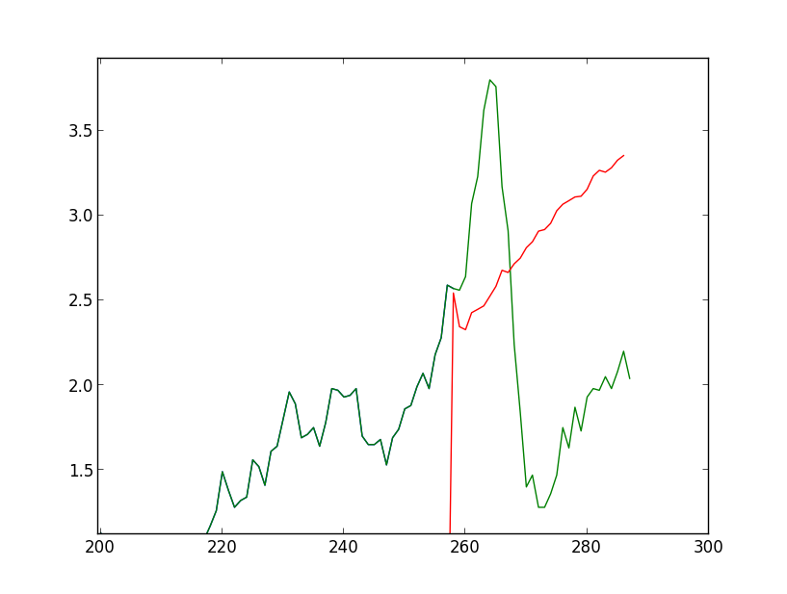
How did this go?
Errors could be massive, like this

Slide 6
I also found that the general shape is what is important.
It is easy (generally speaking) to figure out if something is going to continue going up, or down.
Predicting the actual price gets much trickier and near impossible to do accurately.

Slide 7
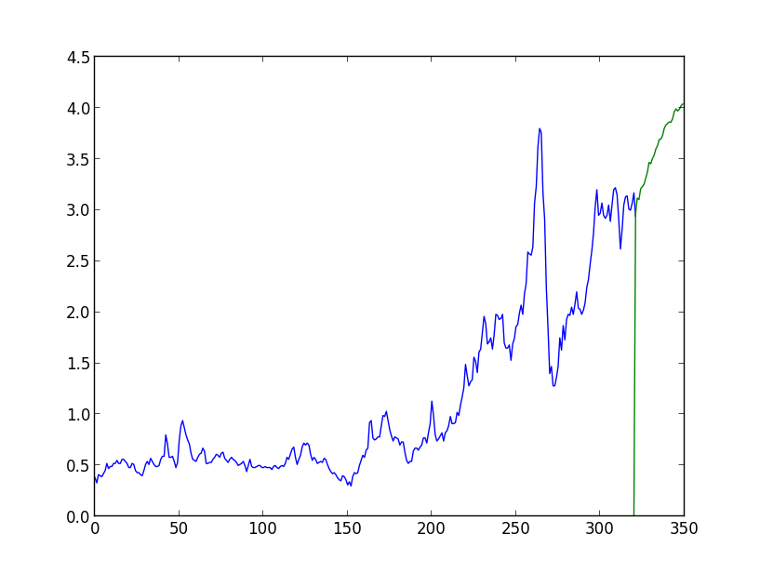
So far…
My prediction for April 2013 was 3.12
According to my updated data, it is 2.67/gal

